Slide 1
5. The Visual Basic Language
ActiveX
Prof Yousef B.Mahdy

Slide 2

As a Software Engineer…
We are required to:
Adopt Good Software Design Principles
Document Code for Maintainability
Develop and Use of Reusable Software

Slide 3
Sharing Data between Applications
Clipboard
Dynamic Data Exchange (DDE)
Object Linking and Embedding (OLE)
ActiveX

Slide 4
Clipboard
First sharing method available with Windows
Holding area where information can be copies and transferred
Limited to a single object
No way to automatically update data placed on clipboard

Slide 5
Dynamic Data Exchange (DDE)
Introduced in later Windows versions
Applications can exchange data and commands while running
A connection is made between the two applications
Data can be automatically updated and transferred

Slide 6
Object Linking and Embedding
Introduced with Windows 3.1
More sophisticated technique than DDE to achieve same results
Not limited to data and commands
Method of combining data created by different applications

Slide 7
How OLE Works
Embedding
Linking
Server Application
Server Application
Object copied
Object linked
Container Application
Container Application

Slide 8
How OLE Works
Embedding
Linking
If you
modify the source object
Server Application
Server Application
Link updates and retrieves current source object
Embedded (copied) object does not change
Destination Application
Destination Application

Slide 9
OLE Terminology
Compound document - document containing elements from multiple applications
Embedded object - original object is copied and stored in the compound document
Linked object - original object remains stored in original file and is linked to container document
Container document - the compound document that contains elements from multiple applications

Slide 10
New and Old OLE Terminology
Container application
  previously called client or destination
  application that receives the object
OLE Container control
  previously called OLE client control
  permits an OLE object to be added to a form
Server application
  previously called source
  application that creates the object

Slide 11

ActiveX is...
… a way to make
Reusable Software Components

Slide 12

ActiveX’s counterparts are...
ActiveX is Microsoft's answer
  to Sun’s Java technology
An ActiveX control is roughly equivalent to a Java applet

Slide 13
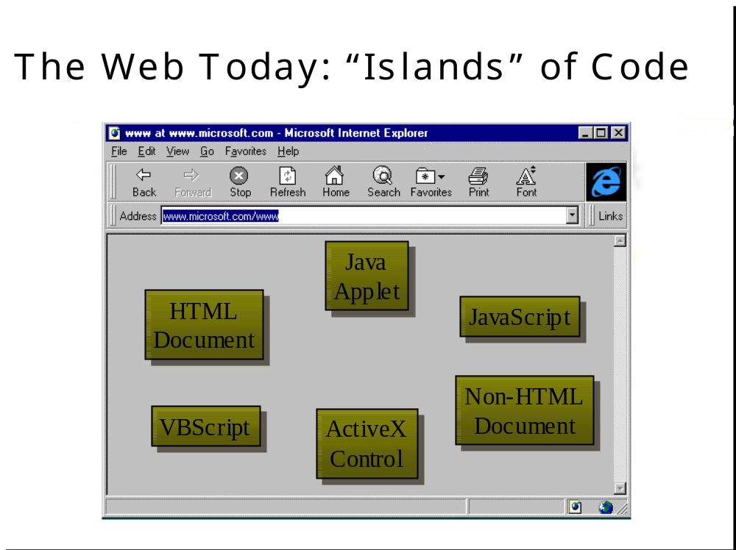

Slide 14
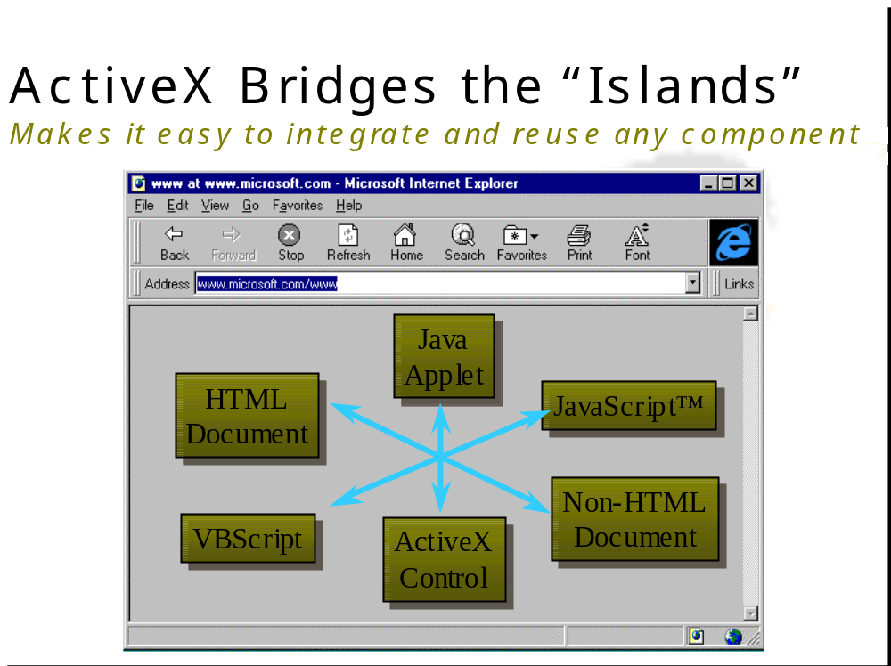

Slide 15
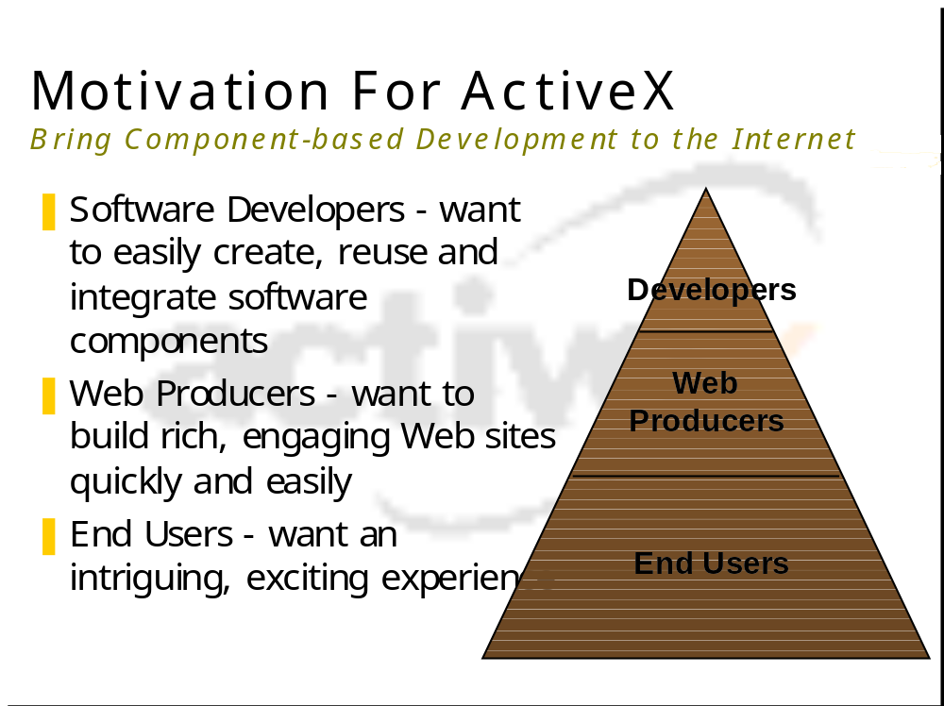

Slide 16
What is an ActiveX control...
A marketing name for a set of technologies and services, all based on the Component Object Model (COM)
A COM-based object that can
  Draw itself in its own window
  Respond to events (such as mouse clicks)
  Be managed through an interface that includes properties and methods similar to those in Automation objects
Formerly known as OLE controls
Can be installed in dialog boxes or any ActiveX control container application, including WWW web pages & VB applications
The only limitation on the kinds of ActiveX controls you can create is your imagination

Slide 17
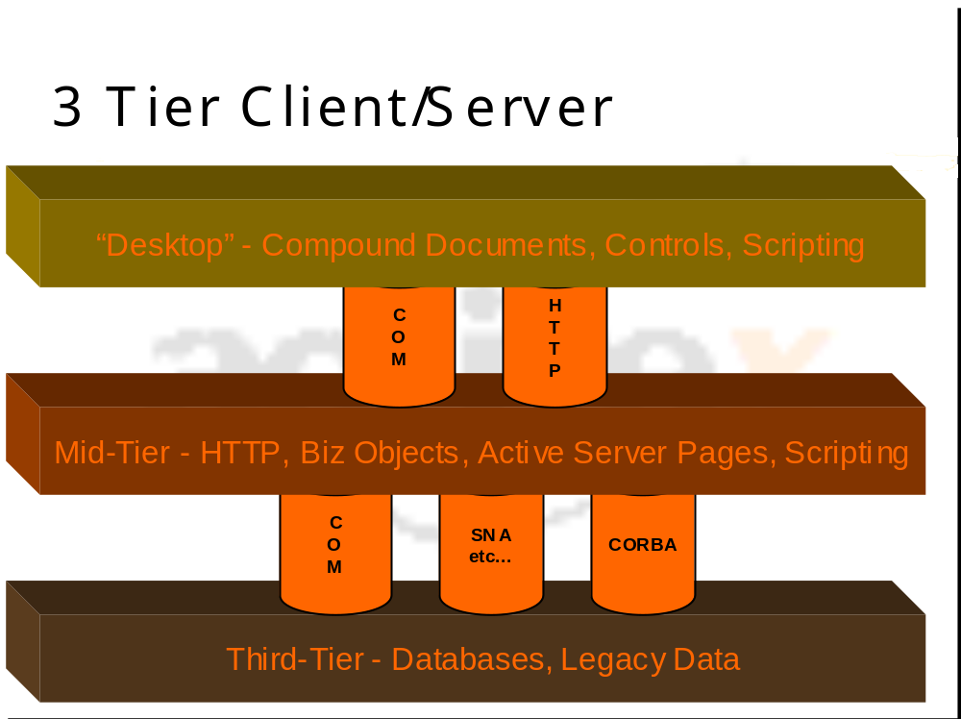

Slide 18
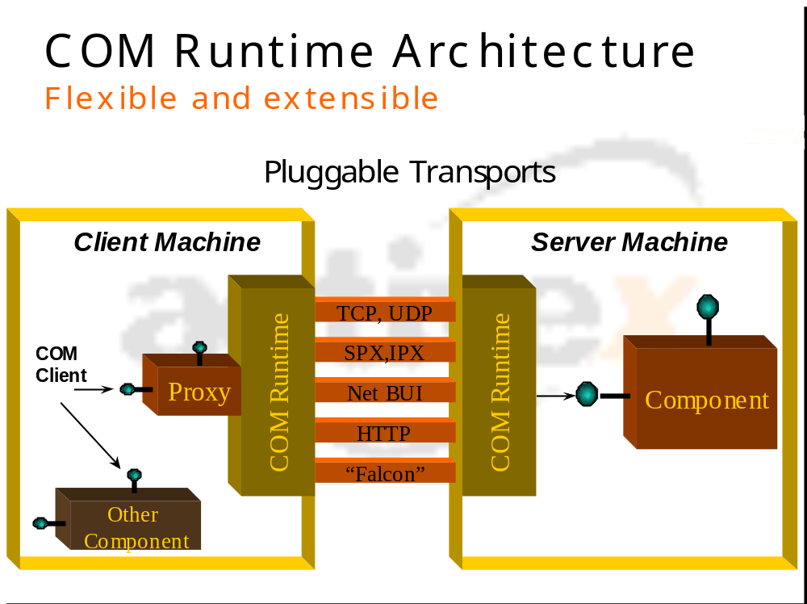

Slide 19
In simple words …
ActiveX is an extension to the VB toolbox
You can use ActiveX controls just as you would any of the standard built-in controls (such as CheckBox control)
When you add an ActiveX control to a program, it becomes part of the development and run-time environment and provides new functionality for your application
ActiveX leverages your capabilities as a VB programmer by retaining some familiar properties, events, and methods

Slide 20
Who Benefits?
Independent software vendors
Build components in any language, any development process
Sell independently or in bundles
No central coordination required
Corporate developers
Buy from competitive market rather than build
Large projects benefit from component discipline
Anyone doing software integration

Slide 21
ActiveX Technology
ActiveX servers or ActiveX components
  previously called OLE servers or OLE automation servers
  originally ActiveX referred to software components that were created for the Web using OLE technology
  ActiveX now refers to a wide range of communication techniques where applications make their capabilities available to other applications

Slide 22
ActiveX Overview
ActiveX is the umbrella name Microsoft applies to developer technology that implements the component object model (COM). At its heart, COM allows applications to communicate with each other and use each other's features without regard to the original development language, date of development, or version compatibility. The component object model started from the concepts of object-oriented programming (OOP) and extended that model into the operating system to allow any COM program object to communicate successfully with any other COM object supporting the desired interfaces.

Slide 23
OBJECT-ORIENTED PROGRAMMING
Object-oriented programming provides disciplines and methods for source code re-use and recycling. OOP engineering concepts define an environment in which program objects model "real-world" objects. Each object is responsible for its own data, program logic, lifetime, and interfaces to the outside world. Formally, the academic experts tell us that "true" objects must support encapsulation, inheritance, and polymorphism.
Encapsulation means that each object provides a safe container (or capsule) for its properties (data) and methods (code). The object defines which properties and methods it will allow other objects to see (public) and which ones remain only inside the object (private).
Inheritance means that a new object can be defined as a "kind of" another object and gain all the "parent" object's properties and methods without doing any work.
Polymorphism is the capability of a derived object to change or override the inherited methods of its parents. You can have a dog object with a method to bark, and you can then have a big dog and a little dog inherited from the parent dog, each with a bark--but those two barks can be different (woof, and WOOF WOOF, for example) if that method is overridden in the new object.

Slide 24
COM Has Its Roots in OOP
The component object model (COM) and the distributed component object model (DCOM) extend the object-oriented programming (see sidebar) paradigm to allow preexisting software applications and objects to interact through a published, stable specification. Microsoft's first widely published implementation of the component object model was Object Linking and Embedding (OLE). This technology allowed previously compiled programs to embed or link their objects (Word documents or Excel spreadsheets) into new documents or forms.
Unfortunately, VB6 does not fully implement object-oriented programming. In particular, polymorphism is given short shrift. In traditional OOP, an object can inherit methods from a parent and then change or override only selected methods without having to re-implement all the parent's methods. With VB6, the programmer must implement all inherited methods of a parent object even if only one method is to be changed. By using the Implements keyword, a programmer tells the VB6 compiler that the class is implementing an interface derived from another class. The "bird" object "flies on" feathered wings. The "airliner" object "flies on" metal wings. In VB6, both the bird and the airliner classes would be declared to implement the FlyingThing class in order to encapsulate the FlyingThing's properties and methods. Both birds and airliners are flying objects, and both implement a "flies on" property, but they appear to share similar properties and behaviors even though they are different objects.

Slide 25
ActiveX and Visual Basic 6
Visual Basic 6 provides several ways to incorporate ActiveX technologies in applications, determined primarily by how the calling application fits into the ActiveX component's environment:
  Code components serve as a library of objects available to calling applications. Built as Visual Basic class modules, the services can be built as dynamic link libraries (DLLs), can be separate EXE files, or can be statically bound into the calling application.
  ActiveX controls are functionally equivalent to the visual controls you put on your forms. They differ from other ActiveX components in that they talk back to the calling application by raising events whose responses can modify the behavior of the control. ActiveX controls run in the caller's process space and communicate directly through memory.
  ActiveX documents are forms designed to appear within Internet browser windows. They are very similar to ActiveX controls because they must be used within a browser container. They are similar to code components in that they can be implemented as DLL or EXE files and run either within the calling process environment (DLL) or as a separate process (EXE).
The three ActiveX methods share the use of the component object model as the operating-environment glue that allows successful communication between components.

Slide 26
What is an ActiveX component? In programming terms, all ActiveX components are really OLE servers, but that doesn’t help us understand what’s going on. It’s better to break things down and look
at the three types of ActiveX components:
  ActiveX controls
  ActiveX documents
  Code components (OLE automation servers)
Let’s take a look at these types now.

Slide 27
Code Components
Code components were formerly called OLE automation servers. These objects let you use their code in other programs. For example, you might have a calculation routine that you expose in a code component; doing so makes that routine available to other programs. Code components can support properties and methods.
If you take a look at the kind of ActiveX components you can build with Visual Basic in the New Project window, you’ll see all kinds:
  ActiveX document DLL, ActiveX EXE
  ActiveX control
  ActiveX EXE, ActiveX DLL (these are code components)
There’s still quite a confusion of terms here—what’s the difference between a DLL and EXE ActiveX component? Let’s explore further.

Slide 28
In-Process Vs. Out-Of-Process Components
If an ActiveX component has been implemented as part of an executable file (EXE file), it is an out-of-process server and runs in its own process. If it has been implemented as a dynamic link library (DLL file), it is an in-process server and runs in the same process as the client application.
If your ActiveX component is an out-of-process server, it is an EXE file, and can run standalone.
Applications that use in-process servers usually run faster than those that use out-of-process servers because the application doesn’t have to cross process boundaries to use an object’s properties, methods, and events.

Slide 29
Which ActiveX Component Do I Want To Build?
With all the different types of ActiveX components to choose from, how do you decide which type of component you want to create? Take a look at this list:
  To build an invisible component that provides routines in code that you can call, build a code component (ActiveX EXE or an ActiveX DLL).
  To build a component that can run in the same process with your application, build an ActiveX DLL.
  To build a component that can serve multiple applications and can run on a remote computer, build an ActiveX EXE.
  To build a visible component that can be dropped into an application at design time, build an ActiveX control.
  To build a visible component that can take over an application window at runtime, build an ActiveX document.
That’s it for the overview of ActiveX controls and documents for the moment—it’s time to turn to the Immediate Solutions.

Slide 30

What is the theory behind this ?

Slide 31
Components
Component: .exe, .dll or .ocx
Client: application / component that uses objects provided by other components
Components characterized by their location w.r.t to the Client
  Out-of-process component
  In-process component

Slide 32
Out-of-process Components (.exe)
Runs with its own thread of execution
Component can process requests on an independent thread of execution notifying the client of task completion using events or asynchronous call-backs. This frees the client to respond to the user
Can run as a standalone desktop application, like Excel or Word (in addition to providing objects)

Slide 33
In-process Components (.dll or .ocx)
Runs in the same process as the client
Fastest way of accessing objects because property and method calls don’t have to be marshaled across process boundaries
Designed for unattended execution (i.e. no user interaction)
Provides objects on any of the client’s threads (in multi-threaded clients) of execution while retaining the performance benefits of in-process method & property calls

Slide 34
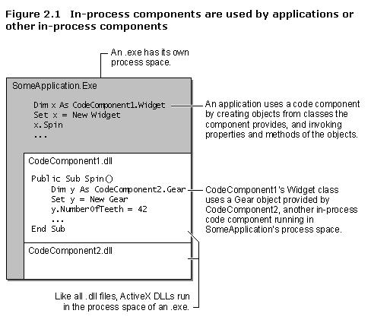
Out-of-process v/s In-process

Slide 35
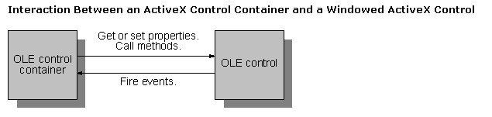
ActiveX - Implementation
An ActiveX control is implemented as an in-process server (typically a small object) that can be used in any OLE container

Slide 36
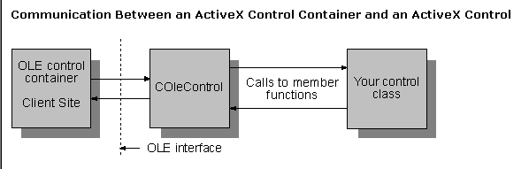
ActiveX - Communication

Slide 37

Enhance your ActiveX Vocab

Slide 38
Terminology (1/4)
Control Class vs. Control Instance
  What you develop (in VB) is a Control Class, a description from which controls will be created (.CTL file)
  When you put a control on a form, you're creating an instance of this control class
Control vs. Control Component
  Controls are objects provided by control components (.OCX files)
  An ActiveX control project contains one or more .CTL files, each of which defines a control class
  When you build the project, VB gives the control component an .OCX extension

Slide 39
Terminology (2/4)
Containers and Siting
  A control instance must be placed on a container object The process of hooking a control instance up to its container is called siting — that is, assigning the control a site on the container
Interface vs. Appearance
  A control consists of three parts: two public and one private
    The control's appearance [public]- users see and interact with it
    The control's interface [public] — the set of all its properties, methods, and events that can be used by any program that includes instances of the control
    The control’s implementation [private] - the code that makes the control work; the effects can be seen, but the code itself is invisible
Notes:
When a control instance has been sited, its events are available as event procedures in the form's code window, and it has access to other services the container provides, such as Extender and AmbientProperties objects.

Slide 40
Terminology (3/4)
Author vs. Developer
  An Author of a control compiles his/her project as a control component, or .ocx file, which may contain one or more controls
  A Developer uses the control (or controls) to create an application, and includes the .ocx file in their setup program
  The user installs and uses the application
  Developers are not the only direct consumers of ActiveX controls - you can design controls for users to place on documents in desktop applications such as Microsoft Office

Slide 41
Terminology (4/4)
Design-Time Instance vs. Run-Time Instance
  When a VB user puts a control on a form at design time, a design-time instance of the control class is created; If the form is closed, this design-time instance is destroyed
  When the project is placed in Run mode, a run-time instance of the control is created when the form is loaded; This is destroyed when the form is unloaded
  When the form once again appears in design mode, a new design-time instance of the control is created
  The property values in the in-memory copy of the .frm file are used by VB to re-create the control as modes change
  When you make the project into an executable, the property values it contains are compiled in, so that a run-time instance of the control can be created when the compiled application is run
Notes:
— clicking its Close button, closing the project, or pressing F5 to place the project in Run mode —

Slide 42

What to do with all this Stuff ?
The Practitioner’s Approach
USE IT !!!

Slide 43

Creating your own Active X Control
3 ways to do so …
  Author your own control from scratch
    Keep MS in mind
  Enhance a single existing control
  Assemble a new control from several existing controls
Choice of Tools
  VB 5.0 or higher
  VC++ 5.0 or higher

Slide 44
10 Simple Steps
Create New Project
  Type = ActiveX Control
Set Project Properties
  Name
  Type = ActiveX Control
For in-process debugging, add a new Project and create a Project group
Make this project your startup project for the project group

Slide 45
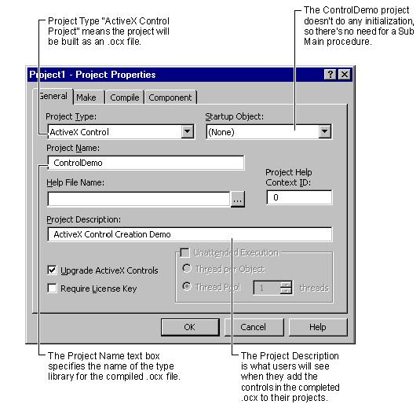
Building ActiveX controls…

Slide 46
10 Steps… (going strong, I guess)
Modify the User Control and add Code to do what you like
This is not simple actually
this is where your work comes in
To test the Control, click on the added project and add the control prepared to it
Set the properties and do the coding – for use of the control
Run the project
Goto the first Instruction on this page

Slide 47
10 Steps… (nearly done)
If you do come out of the loop i.e. when you are done, go to the File menu and choose ‘Make OCX’
You are now ready to distribute the ActiveX control
Be sure to write in your details – as an author – in the AboutBox

Slide 48
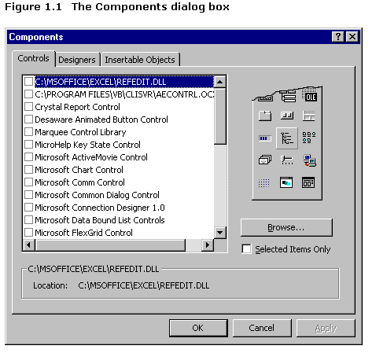
Adding ActiveX components

Slide 49
Building a Hello World ActiveX Control in VB
This set of instructions will show you how to build, test and package a trivial ActiveX control. The control has no code attached to it: it simply displays some text saying 'Hello World'.

Slide 50
Step 1. Building an ActiveX Control Project
Start VB
From the File Menu, select New Project
Select ActiveX Control from the dialog box.

Slide 51
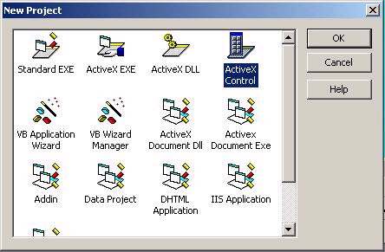

Slide 52
Step 2. Naming your Control Project
From the Project Menu, select Project1 Properties
In the dialog box, change the Project Name and Project description as shown below. This will determine how your 'friendly' name of your component is displayed later on, as well as the name of your compiled .ocx.

Slide 53
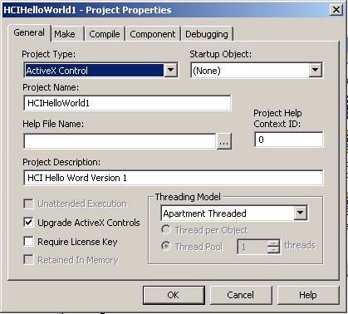

Slide 54
Step 3. Naming your actual control
In the project explorer window, select UserControl1. Then change the Name Property for user control 1 to HelloWord1. Your window should look like the one below.

Slide 55
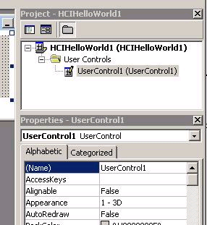

Slide 56
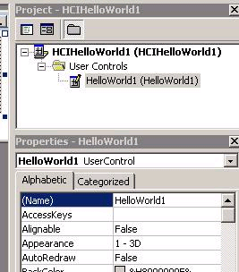

Slide 57
Step 4. Building your control
Drop a label into the Control
Using the Label properties, change its caption to "Hello World" and its font to 14 point
Create a 16x15 bitmap (using Microsoft paint) that has some kind of descriptive image (you can just compose it by writing the letters HW). From the HelloWorld UserControl properties, point the ToolboxBitmap to that bitmap. It will eventually appear in the Toolbox on the left (rather than the generic toolbox control image, shown greyed out on the bottom of the left pane below).

Slide 58
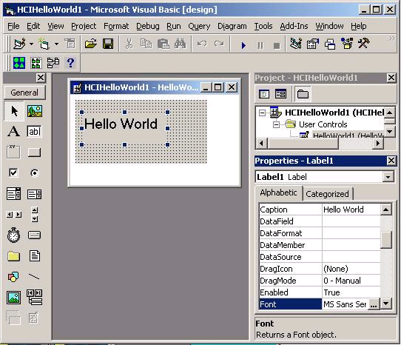

Slide 59
Step 5. Saving your control
This is probably a good time to save the project, just in case! Save it in a folder called (say) HelloWorldV1

Slide 60
Step 6. Testing your control by two methods
Now we will test this simple control via two methods.
The first method uses Internet Explorer. If you click the play button, VB will start Internet Explorer, and you will see your control in it.
The second method for testing a control uses VB directly. From the File menu, select Add Project and then select the Standard EXE icon (the dialog box is the same as the one already seen in Step 1)
From the Project explorer, right-click on Project1(Project1) to raise the context menu, and select 'Set as Startup'. From now on, when you press the play button it will start this program instead of using Internet explorer.
Close the form containing your hello world control. and then raise the Project1 Form.
You will see an icon in the bottom of the toolbar: its tooltip will say HelloWorld1. Select this, and drop it into the form. Your window should look something like the one below.
Feel free to browse the properties of your HelloWorld control in the Properties window: you will see that its properties is not a label! Rather, these are the default properties that every ActiveX control made in VB have.
Just for fun, add a few more HelloWorld controls into your form window. The nice thing about controls is that you can have lots of them!

Slide 61
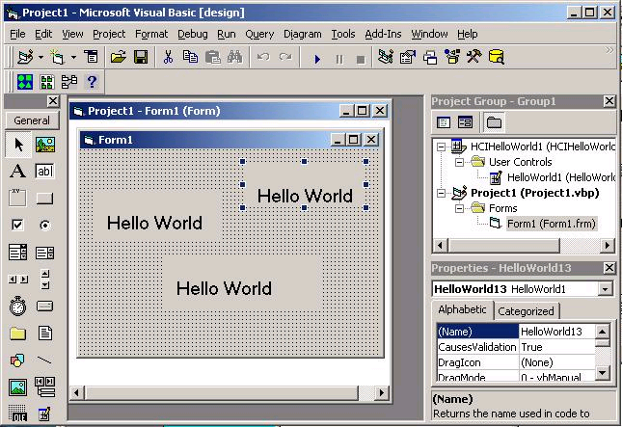

Slide 62
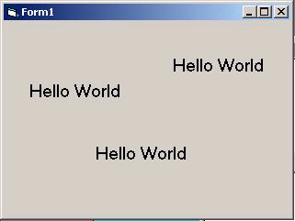
Step 7. Testing the project

Slide 63
Step 8. Saving the project and the project group
Save the project group (this is both the control and the sample application you just made). To do this cleanly, when you save create a new folder called "Test" under "HelloWorldV1" and save everything to that.
Step 9. Compiling your OCX
Through the project explorer, close Project1 and open up your HelloWorld control again.
Compile your control by selecting 'Make HCIHelloWorld1.ocx' from the file menu. Save it in your HelloWorldV1 folder.
Close down VB

Slide 64
Step 10. Testing your OCX from a new VB project.
Start a new version of VB, and create a new .exe project.
Select Components from the Project menu, as shown below. Scroll the list until you find HCI Hello World Version 1. Check the checkbox, and then Ok. This will add the hello world control icon to your controls window.
Repeat Steps 7 and 8.

Slide 65
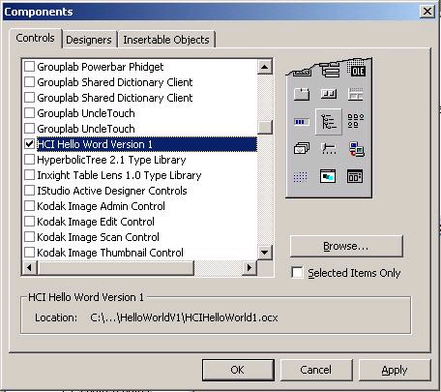

Slide 66
Example 2: ticker control
This pages show you how to use the VB wizard to create a custom ticker control. It illustrates the VB wizard in detail, how properties can be dispatched to existing controls within your own control, and how completely new properties can be created. It also shows an interesting (even though its simple) new type of control!

Slide 67
The Control Wizard
Start up VB and start a new ActiveX Control project (as you see it in Figure 1, below).
Set the project name to tickerControl (Figure 2):
    In the Project Menu, select Project1 Properties
    Change the Project Name to tickerControl

Slide 68
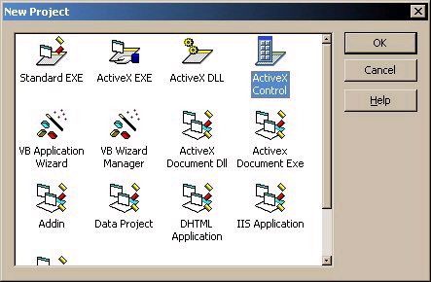
Fig.1

Slide 69
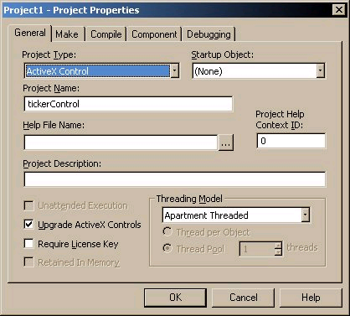
Fig. 2

Slide 70
Set up the layout for the control as pictured below in Figure 3:
    Add a Timer to the control and call it tmrTicker.
    Size and position everything like you see it.
    select the control (your selected object should be "UserControl1") Change it's name to ctlTicker (this is what it will be called when you add it to another project.)

Slide 71
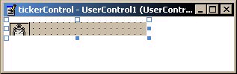
Fig.3

Slide 72
Start the ActiveX Control Interface Wizard (Figure 4) by:
    Go to the Project menu
    Select Add User Control from the menu
    You'll be presented with a dialog with a few options. One of the options is VB ActiveX Control Interface Wizard. Select that.

Slide 73
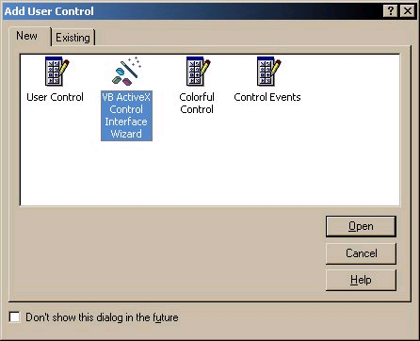
Fig. 4:

Slide 74
Skip the introduction screen. The first real screen you see is the Select Interface Members dialog. You want to have the following items in your Selected names list. Modify it by movins stuff from and to the Available names list (check out Figure 5):
BackColor Property
BorderStyle Property
Click Event
DblClick Event
Enabled Property
Font Property
ForeColor Property

Slide 75
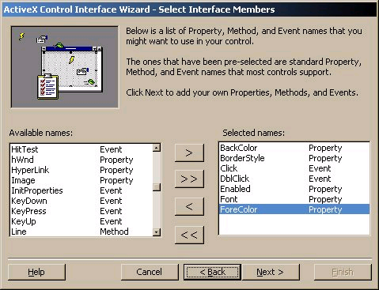
Fig. 5:

Slide 76
The next dialog you get is the Create Custom Interface Members dialog. In it, you can add your own properties or methods that might not come as predefined things in VB. You want to add the following members (guess what? click the New button in Figure 6):
AutoSize Property
Caption Property
Interval Property
RepeatSpacing Property
XChange Property

Slide 77
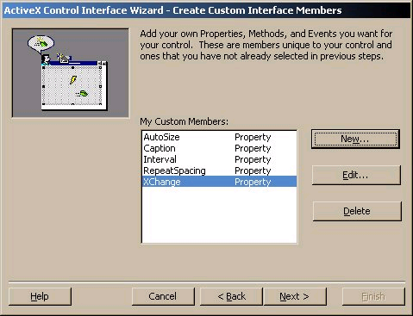
Fig 6

Slide 78
In the next dialog, you get to map all of your properties and events (if you want) to specific controls and member methods / properties thereof. Below is a list of what you should map for this ticker control thing:
Public Name Maps to Control Maps to Member
AutoSize (none)
BackColor UserControl BackColor
BorderStyle UserControl BorderStyle
Caption (none)
Click UserControl Click
DblClick UserControl DblClick
Enabled (none)
Font UserControl Font
ForeColor UserControl ForeColor
Interval tmrTicker Interval
RepeatSpacing (none)
XChange (none)

Slide 79
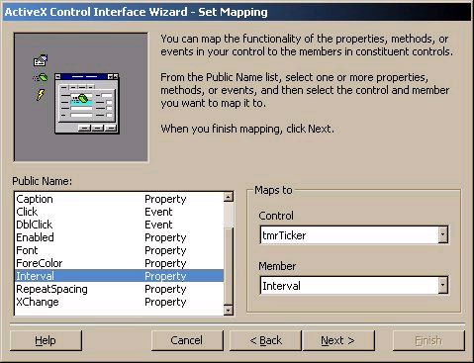
Fig 7

Slide 80
After adding your custom interface members, you are presented with the Set Attributes dialog, which lets you set the attributes for the members you just added. Fill'em in as follows. Note: you can fill in the Description field in the attributes of each member to provide someone using the control with a little bit of feedback about what that property is for.
Public Name Data Type Default Value Run Time Design Time Description
AutoSize Boolean 0 R/W R/W determines whether the control resizes itself to fit the text displayed
Caption String R/W R/W the text displayed
Enabled Boolean 0 R/W R/W determines whether the control is enabled to scroll text
RepeatSpacing Integer 0 R/W R/W the distance in pixels between occurrences of the repeating caption
XChange Integer 0 R/W R/W the distance by which the text is moved when the interval expires

Slide 81
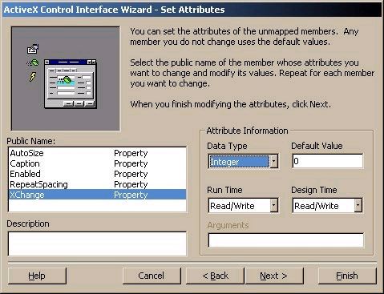
Fig. 8

Slide 82
Hey, we are done! When you hit the finished button, it'll give you a report and give you an option to save that summary report to a file. It may come in handy as a reference, so save it to wherever you're saving the ActiveX project to. Next up: Code!

Slide 83
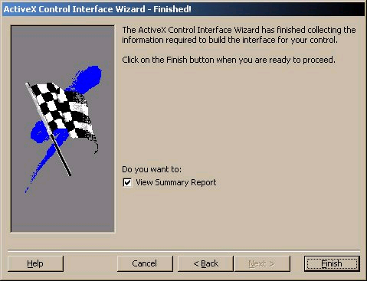
Fig. 9

Slide 84
Code
Okay, the complete code is spat out here. Here's how to read it:
Code generated by VB will appear as greyed out.
Code that you need to add will appear as normal bolded VB code. Rock on!

Slide 85
DLL – Instancing
Every class module has two properties, the class name and the Instancing property. Instancing is not technically a project option (which is, after all, the subject of this chapter). But it has an enormous impact on the behavior of objects in a project. It is also one of the most confusing properties to understand, though I think you'll find it quite easy to understand with the background you have gained in this book so far.
The Instancing property can have the following values:
Private
PublicNotCreatable
SingleUse
GlobalSingleUse
MultiUse
GlobalMultiUse

Slide 86
PublicNotCreatable
These objects are exposed in the component's type library and are accessible by applications using the component, but only if the object is created and provided by the component itself. In other words, no outside application can create an object of this type. However, if an outside application has access to a different object in the component, that object can create a PublicNotCreatable object and pass it to the outside application through a function call or property.

Slide 87
SingleUse
When SingleUse instancing is chosen, each time you create an object of this type, a new instance of the EXE server is run. This is a rather inefficient way of implementing objects and is typically used only for the top-level object in a complex object model that consists of PublicNotCreatable objects. Because of the high overhead involved, you are unlikely to want too many of these types of objects running on your system at any given time.

Slide 88
MultiUse
This instancing option allows a single server to support any number of objects of a given class. The objects can be created by applications using the New operator or the CreateObject function.
In the case of an EXE server, all instances of the object run in the process space of a single instance of the server. In the case of a DLL server, each object runs in the process space of the calling application, as described earlier.

Slide 89
GlobalMultiUse
If you've been using Visual Basic for a while, you are probably familiar with something called a global object, though you may not know it under that name. For example, when you add a form named Form1 to your application, you can refer to it in your code by simply typing in: Form1.method. For example, the command: Form1.Show, shows the form.
In the same way, you can refer to the global Printer object. In each case you can reference the object without actually creating an instance of the object. You don't actually have to create a Printer object or Form1 object in order to use it.

Slide 90
Example:
The GlblTest.vbg group contains two projects that demonstrate creation and use of global objects. This demonstration can be run entirely within the Visual Basic environment. The GlobalTest project (GlblTst.vbp) contains class MyGlobalClass, which is set to GlobalMultiUse instancing. It contains the following method:
Public Sub Message()
MsgBox "I've been accessed"
End Sub
Private Sub Class_Initialize()
Debug.Print "MyGlobalClassObject created"
End Sub
Private Sub Class_Terminate()
Debug.Print "MyGlobalClassObject deleted"
End Sub
The object's Initialize and Terminate events are used to keep track of when instances of the object are created and deleted.

Slide 91
Example:
The GlobalTestClient project contains a form with two command buttons. The form code is shown below:
' Demonstration of global instancing
Private Sub cmdGlobal_Click()
Message ' This works
GlobalTest.Message ' Fully qualified - also works
End Sub
' The other way works as well
Private Sub cmdObject_Click()
Dim gbtest As New MyGlobalClass
gbtest.Message
End Sub
As you can see, you can access the object with either the fully qualified project.method name (GlobalTest.Message) or by simply typing in the method name. In either case Visual Basic automatically creates an instance of the object when you access the method.

Slide 92
Methods and Properties
A class module interface is made up of functions, subs, and properties.
But wait a minute. A function and a sub are really the same thing except for the fact that one returns a value and the other doesn't-not a great difference. In fact, both are commonly referred to by the term method.
And you already know from earlier in the book that a property is internally implemented by two methods, one to set the property and one to retrieve the property value.

Slide 93
Properties
A property can be implemented in two ways: by simply declaring a public variable in a form or by implementing separate property procedures. The Get property procedure returns the value of the property. The Let property procedure is used to assign a value to the property. The Set property procedure is used to set an object reference to the property.
In most cases you will want to use property procedures. This is because property procedures allow you to add data validation, error checking, and other functionality to the process of accessing a property. Even if you are sure that you will never need this additional functionality, it's a good idea to use property procedures just in case you change your mind in the future. Keep in mind that Visual Basic implements a property internally with property procedures, even if you declare it as a public variable.
You can make a property read-only by not writing a Property Set or Property Let method for the property. You can make it write-only by leaving out the Property Get method.

Slide 94
The syntax of assigning the results of a function is identical. Take these two implementations for a method/property called ErrorResult.
Public Function ErrorResult() As Long
ErrorResult = 5 End
Function
Property Get ErrorResult() As Long
ErrorResult = 5
End Function
Both can be assigned as follows:
Myresult = AnObject.ErrorResult
However, the reverse direction is not true. You can add a Property Let function for ErrorResult such as this:
Property Let ErrorResult(vNewValue As Long)
' some internal operation that is appropriate for this property
End Function
And now perform the assignment:
AnObject.ErrorResult = somenumber

